Slide 1
UNIT II DIVIDE AND CONQUER
Session – 9

Slide 2
Syllabus
Introduction, Binary Search - Merge sort and its algorithm analysis - Quick sort and its algorithm analysis - Strassen's Matrix multiplication - Finding Maximum and minimum - Algorithm for finding closest pair - Convex Hull Problem

Slide 3
Introduction
Divide / Break
Conquer / Solve
Merge / Combine

Slide 4
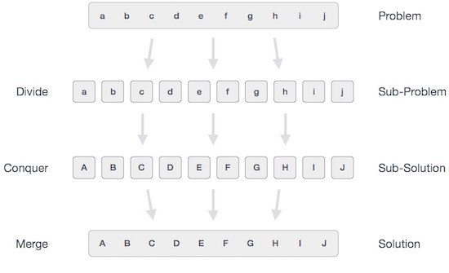

Slide 5
BINARY SEARCH ALGORITHM
Binarysearch(a[n], key)
start=0; end=n-1;
While(start<=end)
{
mid=(start+end)/2;
return mid
if(a[mid]==key)
return mid;
else if(a[mid]<key)
end=mid-1;
else
start=mid+1;
}
return -1;

Slide 6
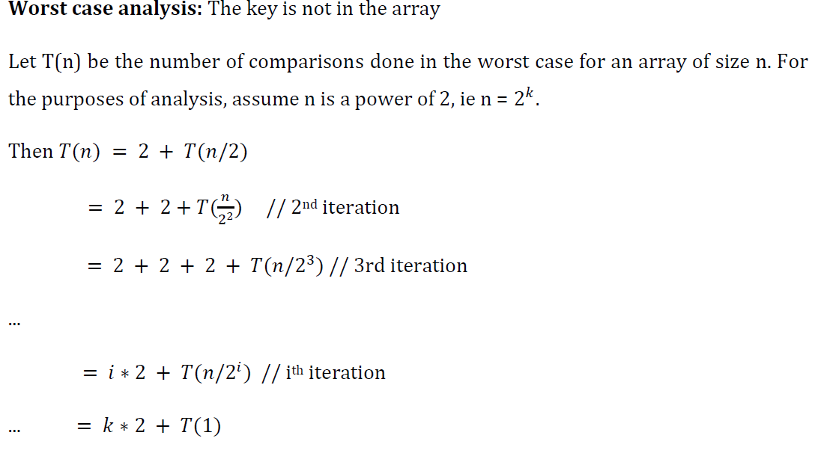
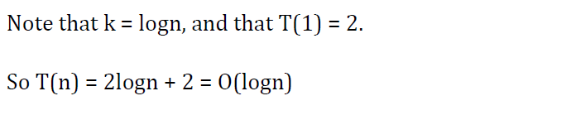
ANALYSIS

Slide 7
Using Master’s theorem
T(n) = T(n/2) + 1
T(n) = aT(n/b) + f(n) where a >= 1 and b > 1
a = 1 b = 2 f(n) = 1 = n⁰
If f(n) < O(n^{log}_{b}ª), then T (n) = ϴ (n^{log}_{b}ª).
If f(n) = ϴ (n^{log}_{b}ª) , then T (n) = ϴ (n^{log}_{b}ªlogn).
If f(n) > Ω (n^{log}_{b}ª), and f(n) satisfies the regularity condition, then T (n) = ϴ (f(n)).
Calculate n^{log}_{b}ª = n^{log}₂¹ = n⁰
Compare with f(n). Since f(n) < n^{log}_{b}ª
i.e. n⁰ = n⁰
Case 3 is satisfied hence complexity is given as T(n) = Θ(f(n)) = Θ (n⁰logn) = Θ (logn)

Slide 8
Worksheet No. 9

